Slide 1
Design Process
Instructor:

Slide 2
Agenda
Design process
Design workflow
Design documents

Slide 3
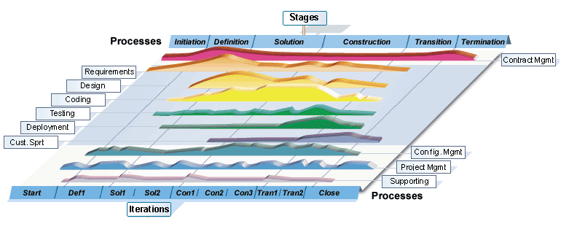
Design Processes

Slide 4
Design process Overview
Purpose:
Develop solutions to requirements
Create Architecture design, high level and detail design documents
Software Requirement Specification
Select from alternative solutions
Develop design documents
Review design documents
Alternative Design solutions
Evaluation Criteria DAR report
ADD, HLD, DDD
Approved Design
Documents

Slide 5
Design process Develop the design
AD/HLD, DD: Step and Activities
Review and approve high level design:
Prepare for high level design review, inform and send documents, records to the reviewers
Review: Design methodology, system architecture, feasibility of detail design process and coding
Approve high level design
Detail design:
Design Screen, Report, Algorithms and other modules
Create detail design document

Slide 6
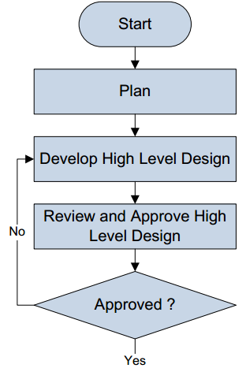
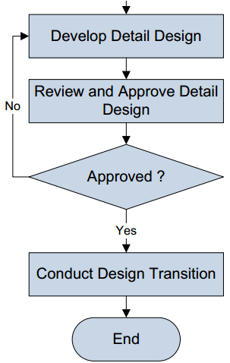
Design Work Flow Overview
II
II

Slide 7
Design Documents High-Level Design
A High-Level Design provides an overview of a solution, platform, system, product, service, or process.
Such an overview is important in a multi-project development to make sure that each supporting component design will be compatible with its neighboring designs and with the big picture.
The highest level solution design should briefly describe all platforms, systems, products, services and processes that it depends upon and include any important changes that need to be made to them.
A high-level design document will usually include a high-level architecture diagram depicting the components, interfaces and networks that need to be further specified or developed.

Slide 8
Design Documents High-Level Design Document Sample
Refer to [Software High Level Design Document_Sample.doc] file

Slide 9
Design Documents Detailed Designs
Detailed design documents includes the following documents:
Screen Design Document
Data Design Document
Class Design Document

Slide 10
Design Documents Detailed Design – Screen Design
We have to define the following items in Screen Design document:
Screen follow
Screen structure or transition between screens. It should be in diagram
Screen’s component list
Screen picture
Refer to [Software Detailed Design Document_Sample01.docx] file

Slide 11
Design Documents Detailed Design – Data Design
We have to define the following items in Screen Design document:
Entity relationship diagrams
Tables structure
Fields structure
Files structure
Design the format of codes (ex. Customer codes, product codes )
Refer to [Software Detailed Design Document_Sample01.docx] file

Slide 12
Design Documents Detailed Design – Class Design
We have to define the following items in Class Design document:
COMMON package declaration
Error, exception handling
Log, trace and debug
Performance optimizing mechanism
Class diagram & Sequence diagram
External interface
Method declaration
Refer to [Software Detailed Design Document_Sample02.docx] file

Slide 13


